Slide 1

GO Team Meeting: October 10th

Slide 2
Every Child, Every Chance, Every Day!
PBSA and Price Vision and Mission
PBSA Cluster Vision and Mission
Vision : We graduate empowered change agents who create positive, long-lasting impact in their communities.
Mission: We cultivate students’ skills and agency in pursuit of their unlimited potential.
Price Middle School
Vision : Luther J. Price Middle School exists to improve our community by empowering and equipping our students with the skills needed to graduate and live liberated choice-filled lives.
Mission: Students at Price Middle School are empowered through academic acquisition, leadership development, authentic problem solving, and student-centered ownership leading to them reaching their unlimited potential.

Slide 3



PBSA Instructional Priorities
‹#›
Growth Mindset
High Expectations
High Quality Instruction
Strong
Curriculum
Clear Roles & Responsibilities
Progress Monitoring
Notes:
Growth Mindset: Encouraging students to embrace a growth mindset by celebrating effort, promoting resilience, and teaching that mistakes are part of the learning process.
High Expectations: Setting clear, high expectations for all students, believing in their ability to meet those expectations, and providing the necessary support to help them succeed.
High-Quality Instruction: Delivering engaging, differentiated, and effective instruction that meets the needs of all students and fosters a positive learning environment.

Slide 4
Recent Events in the Wildcat Den

Slide 5
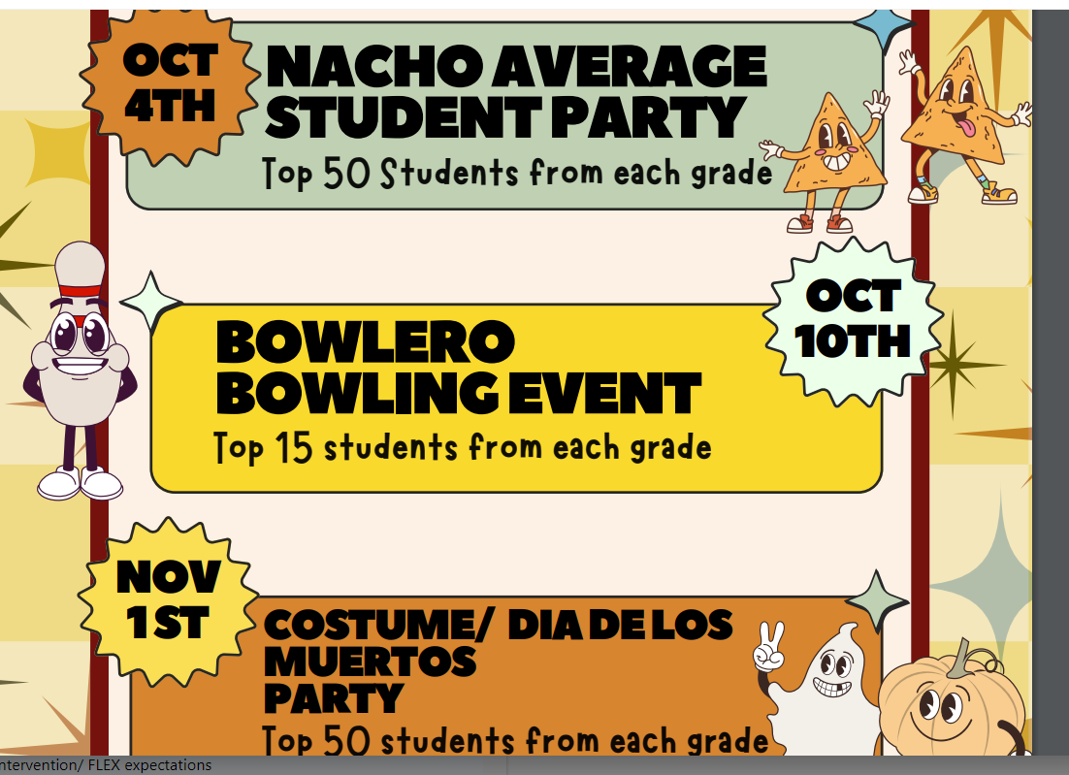
PBIS and Perfect Attendance Recognitions
Attendance Data Results
By May 2025, 75% of students will meet the CCRPI standard for attendances.
August: 66% students met the CCRPI for standard attendance (Candy Bags)
September: 67% students met the CCRPI standard for attendance (Pizza Party)
6th: 61%
7th: 67%
8th: 72%

Slide 6
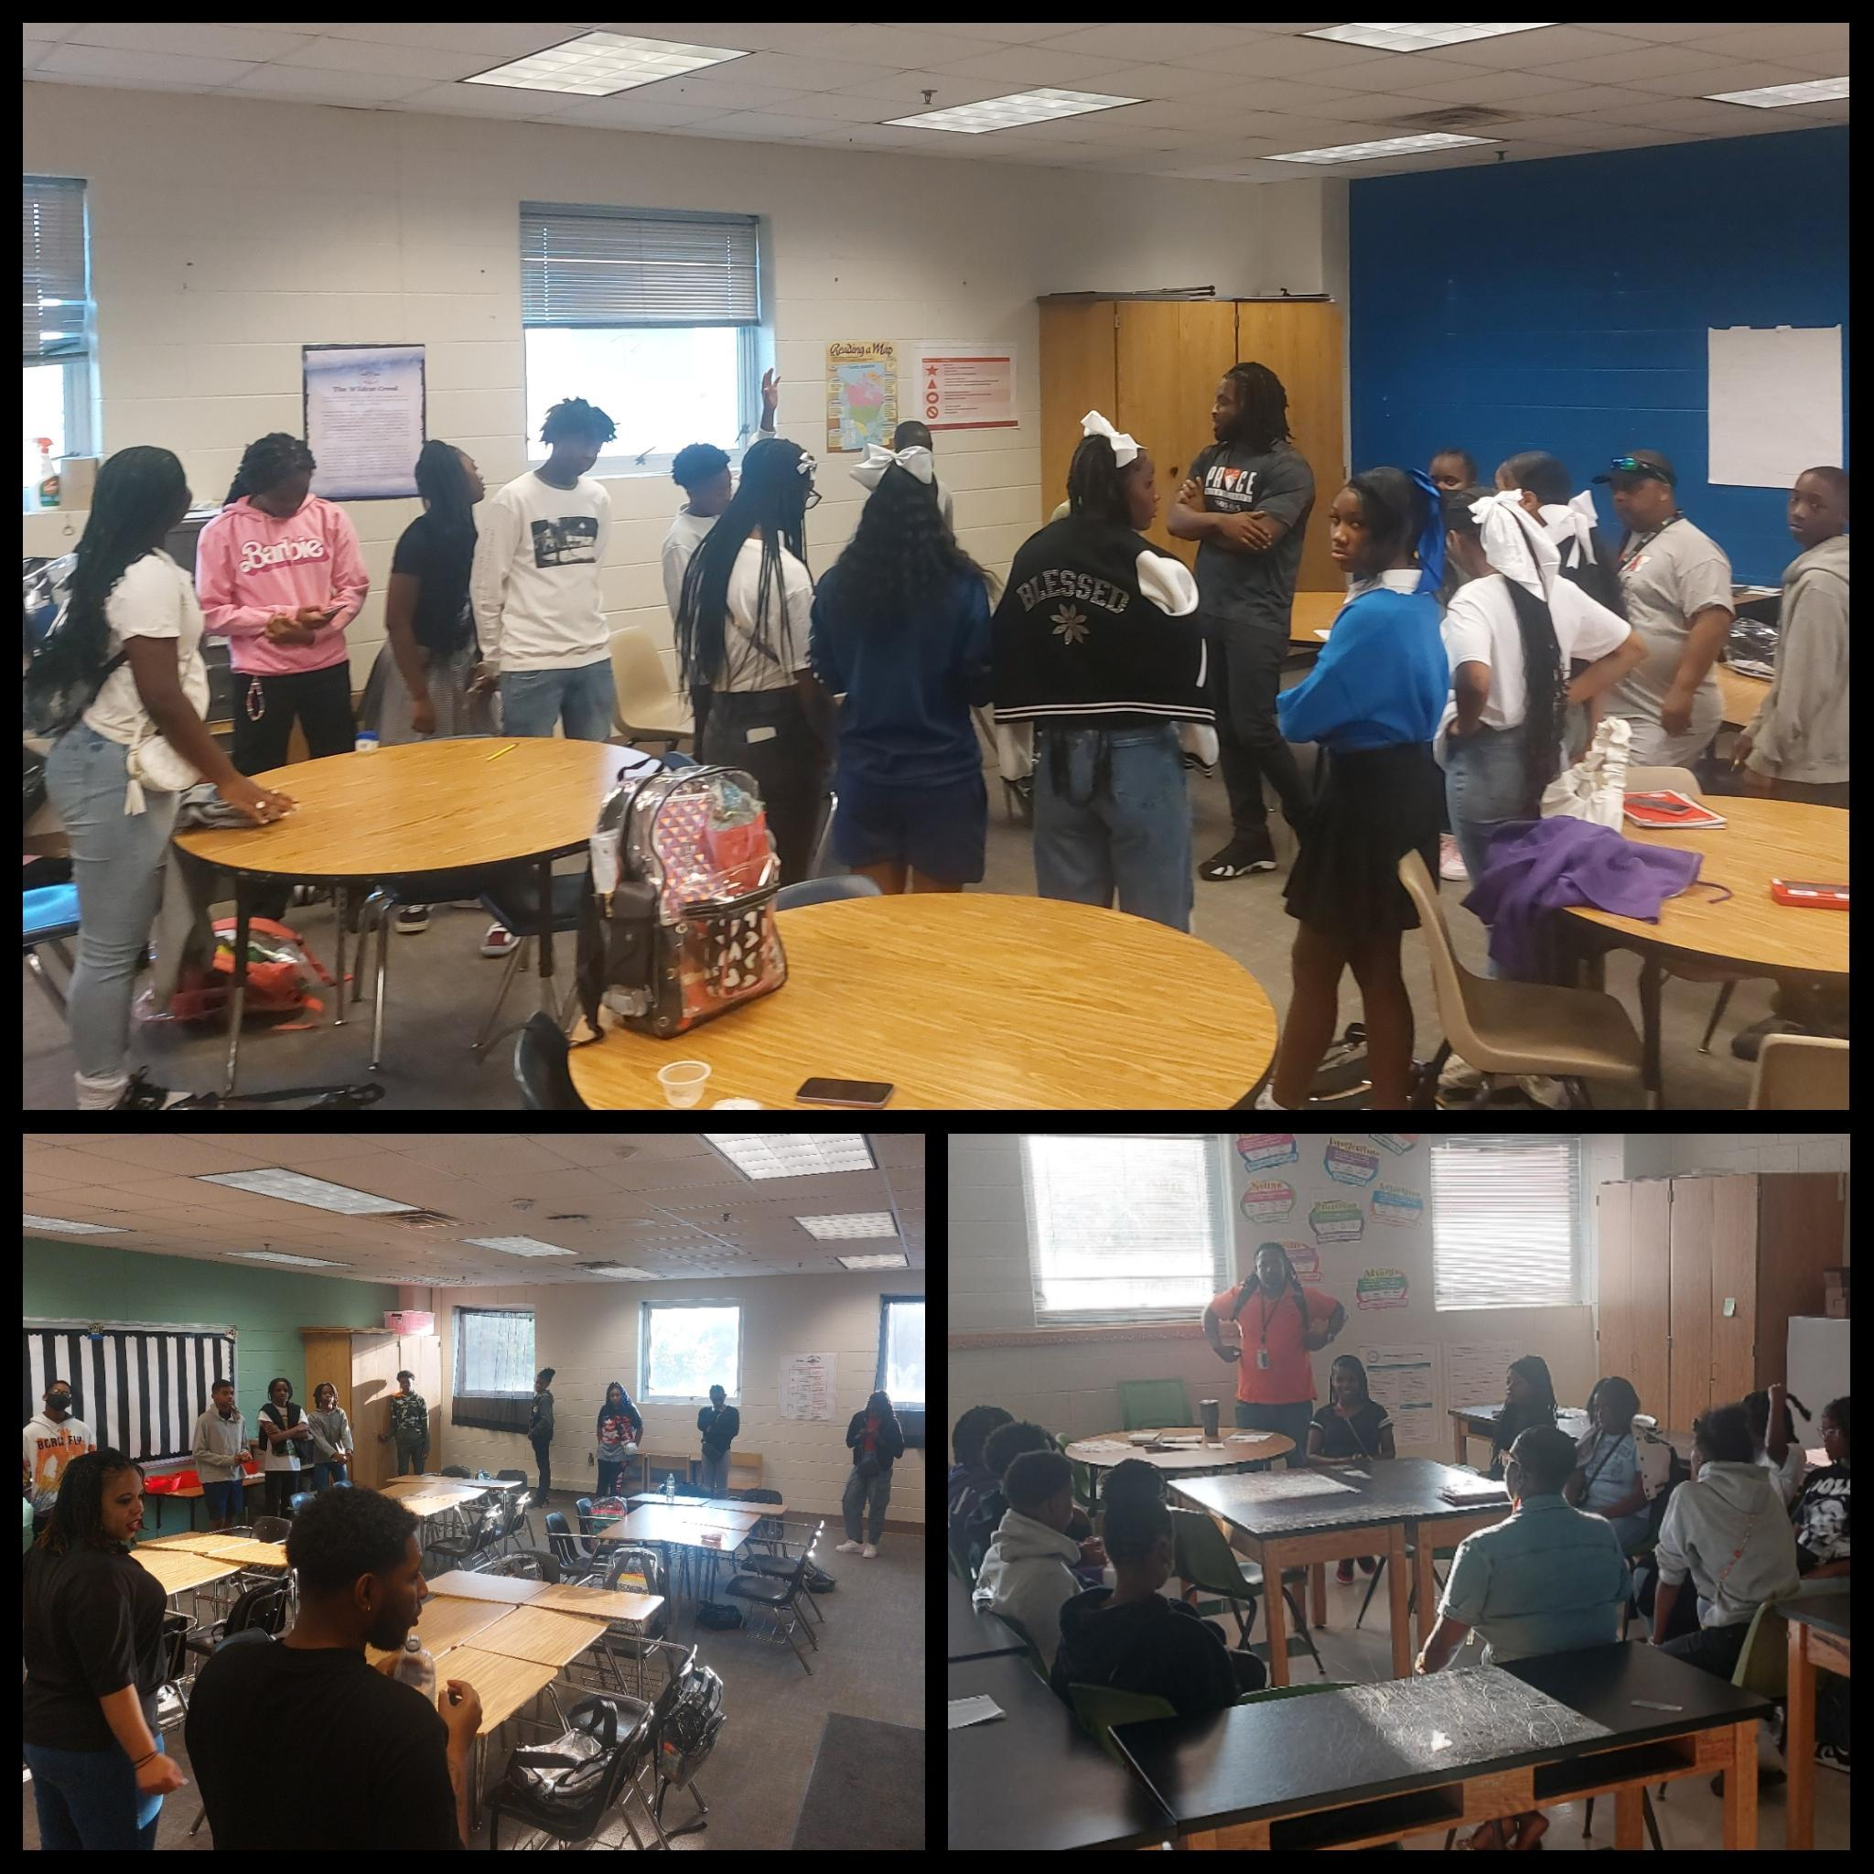
Conversations w/Caregivers Data: September 16-20, 2024
The schoolwide goal was for a total of 120 caregivers to participate
(40 caregivers per grade level)
(10 caregivers per Advisory Group)
We exceeded our goal with a total participation of 144 caregivers!
(We exceeded the schoolwide total from last year’s 1st quarter parent-teacher conferences which was 19 parents)
6th Grade: 27 caregivers
7th Grade: 53 caregivers
8th Grade: 64 caregivers
AWESOME JOB!!!

Slide 7

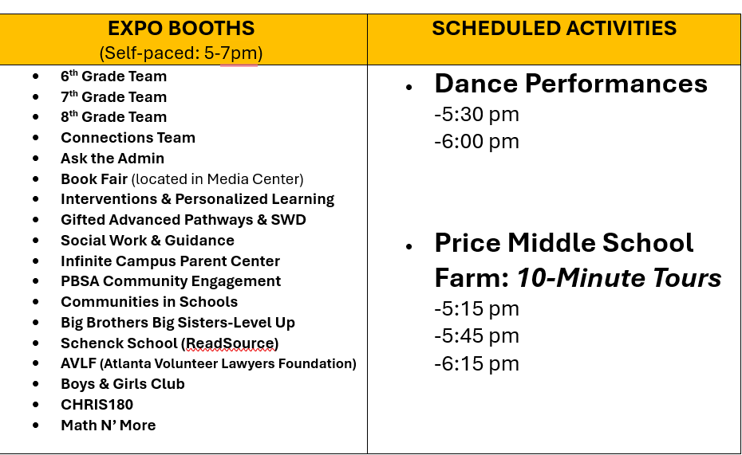
Academic Expo: October 9, 2024
The schoolwide goal was for a total of 60 caregivers to participate
( 20 caregivers per grade level)
25 Caregivers signed up to be a Wildcat Volunteer
We met our goal with a total participation of 65 caregivers!

Slide 8
School Calendar
Tu
7&8 Spanish Field Trip to Plaza Fiesta
23
We
Red Ribbon Week
24
Th
Red Ribbon Week/Farm Fieldtrip to Desomo Place Farm
25
Fr
Red Ribbon Week/Slater Visit- Counselor and Admin
26
Mo
Red Ribbon Week
29
Tu
Red Ribbon Week
30
We
Red Ribbon Week/PSAT (8th Grade)
31
Th
Red Ribbon Week/Oct Sunshine Event
October 2024
11
Fr
School Pep Rally/5&6 GAP Lion King @ The Fox 12pm / Power PD
12
Sa
13
Su
14
Mo
Indigenous Ppl Day (Teacher PL Day)/ Proximity PD
15
Tu
Fall Break
16
We
Fall Break
17
Th
Fall Break
18
Fr
Fall Break
19

Slide 9
School Wide Numeracy Goal
Numeracy Goal
Increase the percentage of students scoring developing and above in math from 41% to 47% Spring 2025.
Action Steps
Math teachers will implement the effective use of the CUBES problem solving protocol to assess student reasoning processes so that students apply the reasoning strategies they learn while using paper and pencil to problems presented on electronic platforms.
Interventionists will provide targeted support with small group differentiation by pushing into Math classes 2-3 times per week so students can access grade level content and complete targeted assignments based on individual needs.
Intentional grade level supports implemented during flex
Demonstration of comprehension, writing, and critical thinking skills in all math classes
2023-2024 Milestones Results
6th
33% developing and above
7th
50% developing and above
8th
71% developing and above
Notes:
–Opportunity to share the vision with teachers and staff.
–Could provide discussion/reflection on how individuals will put the vision into practice.
Ideal Practice/SY24-25 Goal: the vision is developed collaboratively with the teachers and even students providing input.

Slide 10

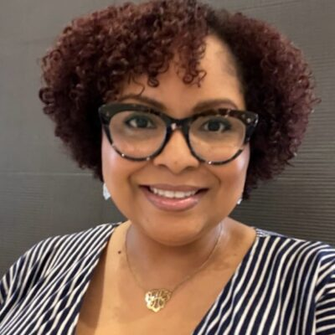

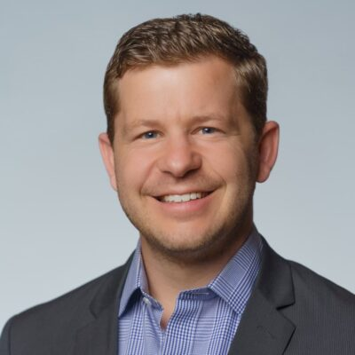

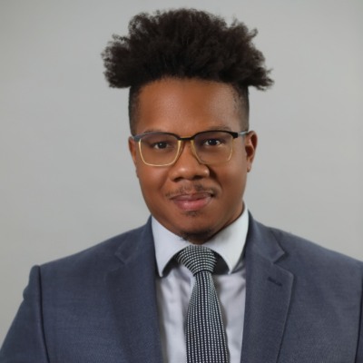
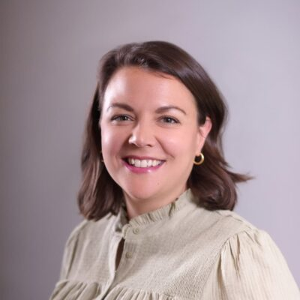
Introducing the Bellwether team
Ajuah Helton | Bill Durbin | Nate Geller | Siobhan Gardner | Emile Session | Kaitlin Beeson
Atlanta, GA | Houston, TX | Athens, GA | Atlanta, GA | Memphis, TN | Libertyville, IL
Project Lead | Project Advisor | Project Manager | Project Support | Project Support | Project Logistics

Slide 11

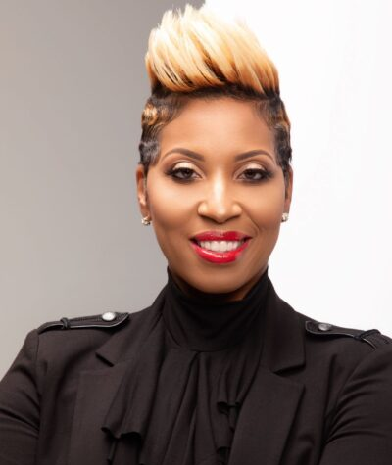
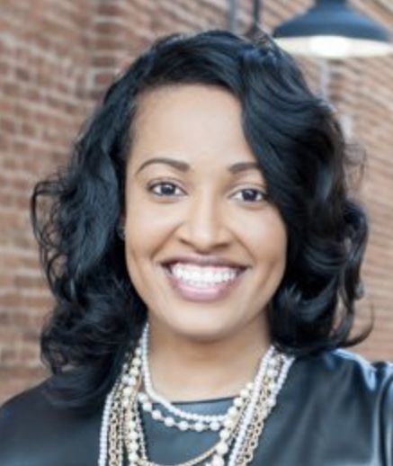
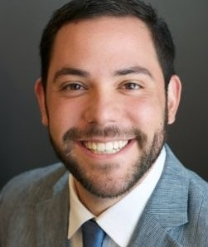
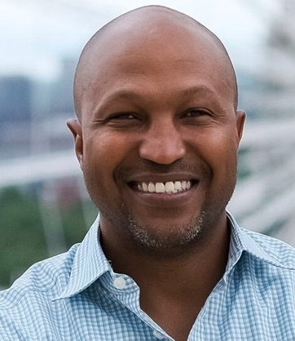
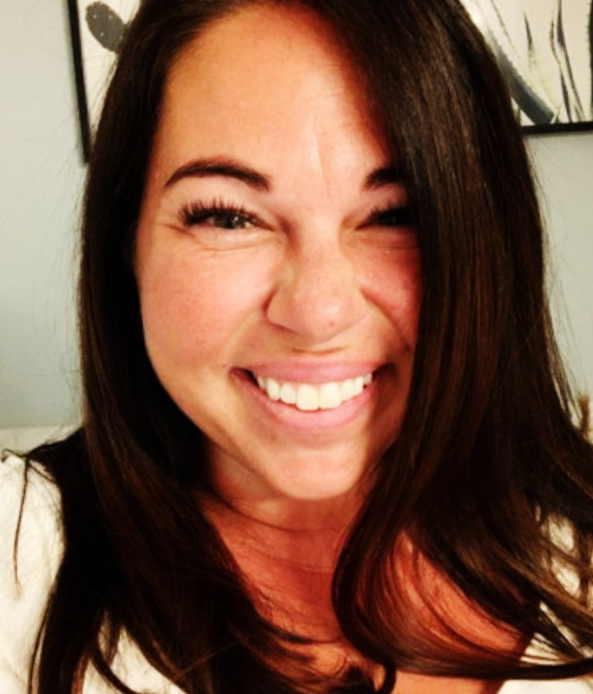
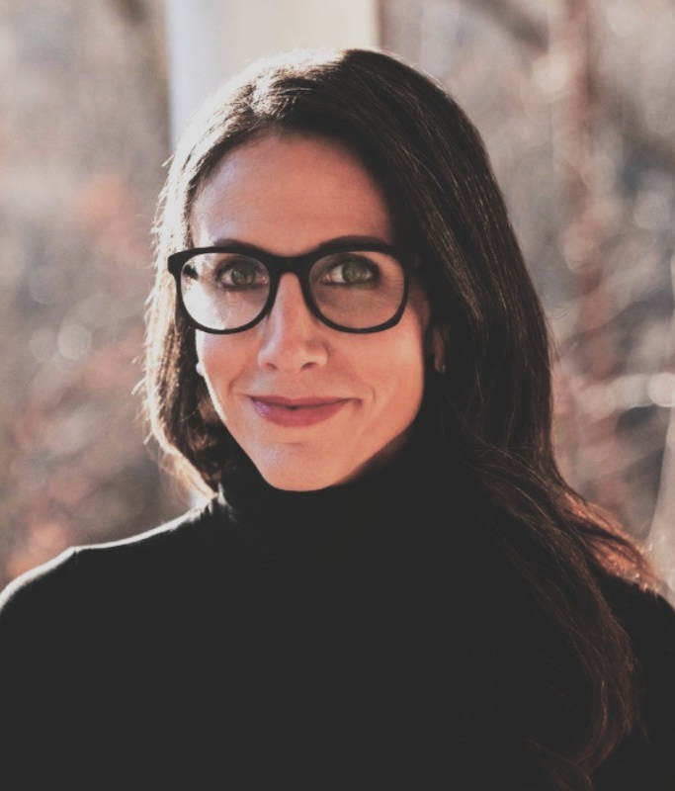
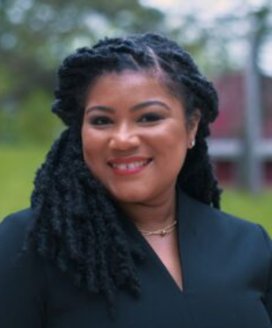
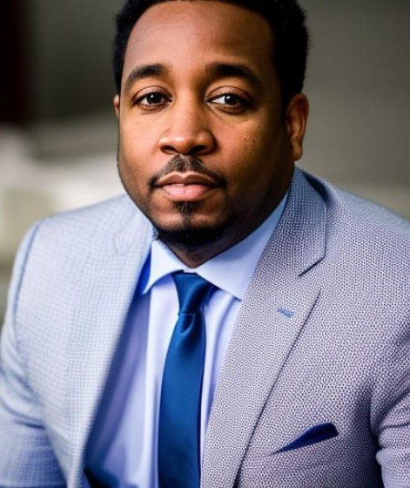
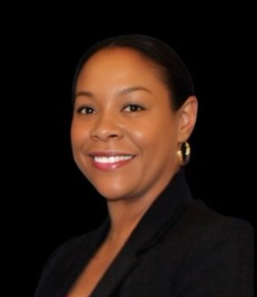
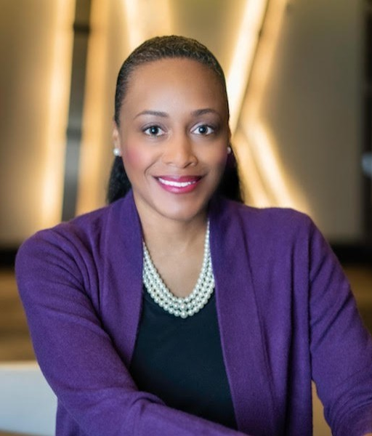
Welcome, Steering Committee!
Project Leads
Jonathan Tugman | Dr. Nikkita Warfield | Dr. Chasha Colbert-Williams | Blake Zimmerman
Chief Operating Officer | Chief Academic Officer | Director of Academic Affairs | Director of Analytics & Strategic Initiatives
Mike Davis | Nichole Stone | Cara Frattasi | Jeronica Harts | Jovan Miles | Natasha Hogan-Mahan | Niomi Henry
Chief Executive Officer | Chief People Officer | Chief of Staff | Director of Community Engagement | Principal, Slater Elementary | Principal, Price Middle | Principal, Carver STEAM HS

Slide 12




We are wrapping up Phase 1 of our work together; this will be the first of three Steering Committee engagements
Phase 0
Setup (1)
Phase I
Build the factbase & ID priorities (4)
Phase II
Develop the strategy (4)
Phase III
Plan to implement (4)
September |  |  |  |  | October |  |  |  |  | November
w/o: 9/2 | 9/9 | 9/16 |  | 9/23 | 9/30 | 10/7 | 10/14 | 10/21 | 10/28 | 11/4 | 11/11 | 11/18 | 11/25 | 12/2
We are here
WS1
WS2
WS3
Draft and refine a graduate profile and intended impact goals
Build out and refine a set of strategic priorities and initiatives aligned to goals
Facilitate a Steering Committee meeting to align on the comprehensive set of priorities and alignment to the Intended Impact
Develop a cross-priority implementation plan that includes goals, owners, resources, timelines, and progress monitoring tools
Estimate resource requirements/ investments for each initiative within a priority; triangulate this against PBSA’s financial position and projections
Develop a high level communications plan for the roll-out of the final strategic plan
Identify any fundraising required to advance each strategic priority
Prepare for and facilitate a final working session
Create work plan and conduct project launch activities
Host kick-off for the PBSA Steering Committee
Deepen understanding of PBSA’s current work and operating model through project kick-off, school visits, focus groups/interviews, and document review
Synthesize insights into a holistic Network Health Assessment (NHA) with a primary focus on academics and leadership
Prepare and facilitate a working session for the Steering Committee
Kick-Off
School Visit
PL Advising Calls
Working Sessions
Holiday

Slide 13
